Slide 1

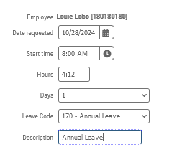
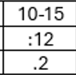
Rounding a Manual Entry
Leave, Missed Clock Ins/Outs, and Projected time are all examples of manual entries that require rounding (UAP2610;3.0). Please use the rounding chart/cross walk. You can use either clock time format (#:##) or decimal format (#.#). You can also use military time.
Leave Example
Annual Leave of 4 hours and 15 minutes starting at 8:00 am.
You can also enter the hours in decimal format at 4.2.
As soon as you tab out of the box, TCP will convert it to 4:12 clock time.
Minute Range
Clock format
Decimal Format

Slide 2
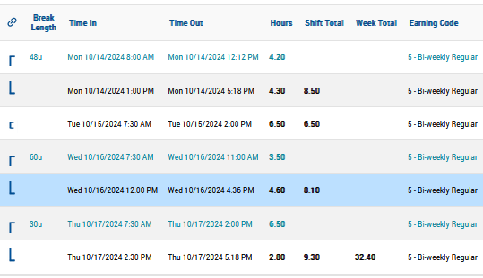
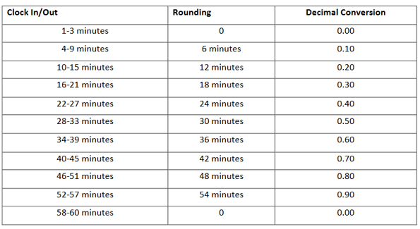
Calculating time needed
In this example, the employee has worked 32.4 of their 40 hours for the week, leaving 7.3 hours to work. (40.00 - 32.4 = 7.3)
The employee will work on Friday from 8am to 12pm and then take lunch, which is another 4 hours. This leaves 3.3 hours. (7.3 – 4.0 = 3.3)
The employee will return from lunch at 1pm and needs to work the remaining 3.3 hours. One to four pm = 3 hours.
This leaves 0.3 hours to work. From the rounding/cross walk, .3 in the decimal column is equal to 18 rounded minutes. The employee can clock out anywhere from 4:16 to 4:21, as minutes 16-21 will round to 18 minutes or .3 in decimal time.

