Slide 1
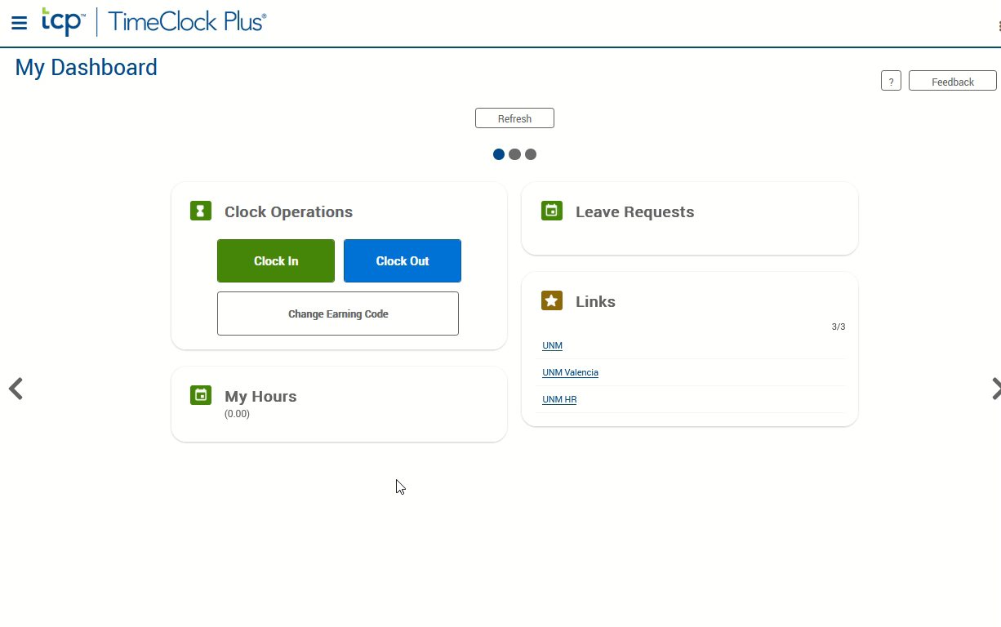
Requesting Leave
Leave requests requiring entering time and/or hours as rounded time. Please refer to the rounding chart.
If not auto started, click the video to the right and push the play button located at the bottom to watch the demonstration.
Click the 3-line “hamburger” menu icon to access the toolbar.
Click Requests.
Click the “plus” sign in the top right-hand corner of the date you’re requesting. Note: if there isn’t a plus key, then that time frame has been closed and you must contact HR-Valencia for assistance.
Choose a preset template from the left or make manual adjustments on the right side of the “Add Employee Request” dialog box.
Date Requested = day leave starts on
Start time = time leave will start
Hours = number of hours you are requesting (If you are entering multiple days, you will still enter the number of hours per day.)
Days = number of days in a row .
If your time off crosses the weekend, you will need to end the request on Friday and start a new request for Monday.
If the number of hours you need is different each day, you will need to enter an individual request for each day)
Leave Code = Sick, Annual, etc.
Description = optional, but do not enter sensitive information
Click the Save Button
An email will automatically be sent to your supervisor. When processed, you will receive an email in return. If approved, the hours will automatically be transferred to your time sheet.

