Slide 1
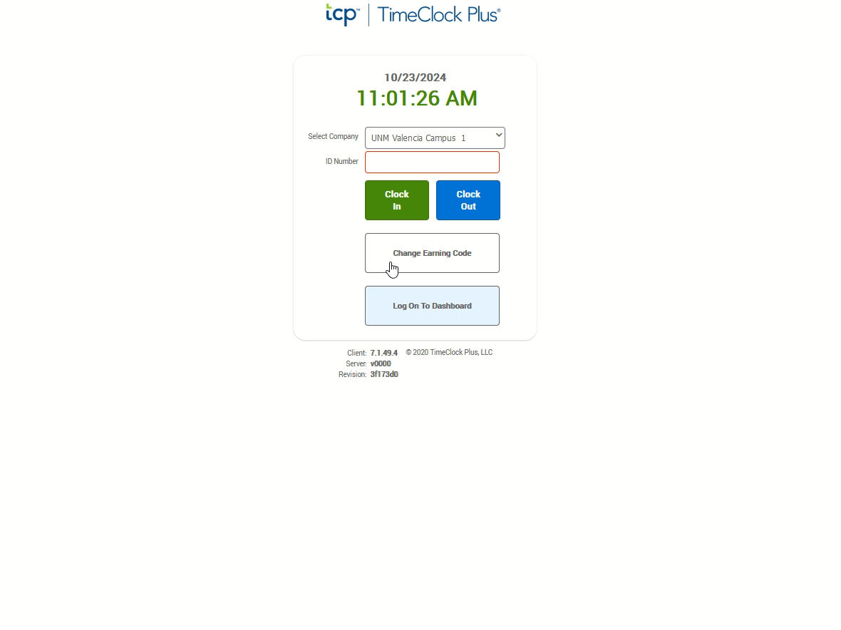
Missed Clock Out
If not auto started, click the video to the right and push the play button located at the bottom to watch the demonstration.
In this example you are attempting to clock in but have a missed clock out.
From the TCP Page, enter your nine-digit Banner ID in the ID Number Box.
Click the blue “Clock Out” button.
Enter your four-digit PIN.
Click “Log on.”
The system will recognize that you are trying to clock in but are missing a clock out. From the “Missed Clock Out” confirmation screen click the “Continue“ button.
The next screen will confirm your last clock in time and ask if you need to manually enter a missed clock out. Click the “Continue” button.
On the Time Entry Missed Clock Out screen, enter the date and the time of the missing clock out. This is a manual entry, so be sure to use the rounding/cross-walk to enter the rounded time.
Enter a note in the note field.
Click the “Continue” button.
From the Summary Missed Clock Out screen, confirm your entry is accurate for the missing clock out. If needed, click the “Back” button to correct. When accurate, click the “Continue” button.
The system will now transition to your clock in segment. From the Select Earning Code Screen, click on the “Continue” button. The earning code should remain at Bi-weekly Regular.
From the Clock In Operation Successful dialog box, click “OK”. Both your missed clock out and your current clock in time are now recorded.

