Slide 1
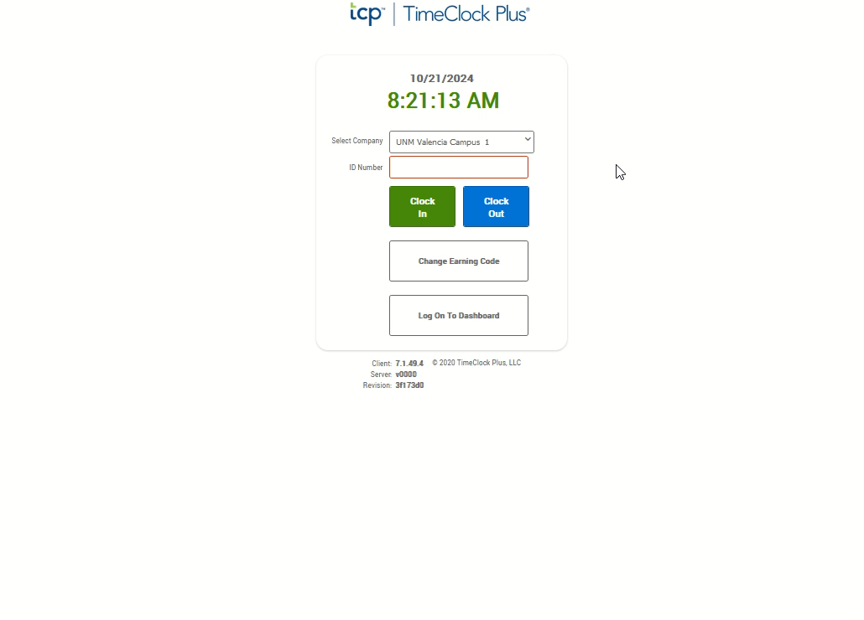
Clocking Out
If not auto started, Click the video to the right and push the play button located at the bottom to watch the demonstration.
From the TCP Page, enter your nine-digit Banner ID in the ID Number Box.
Click the blue “Clock Out” button.
Enter your four-digit PIN.
Click “Log on.”
From the Clock-Out Confirmation Screen, click the “Continue” button.
You should receive a “Clock Out Successful” notification. Be sure to click the “OK” button to complete the clock out.

