Slide 1
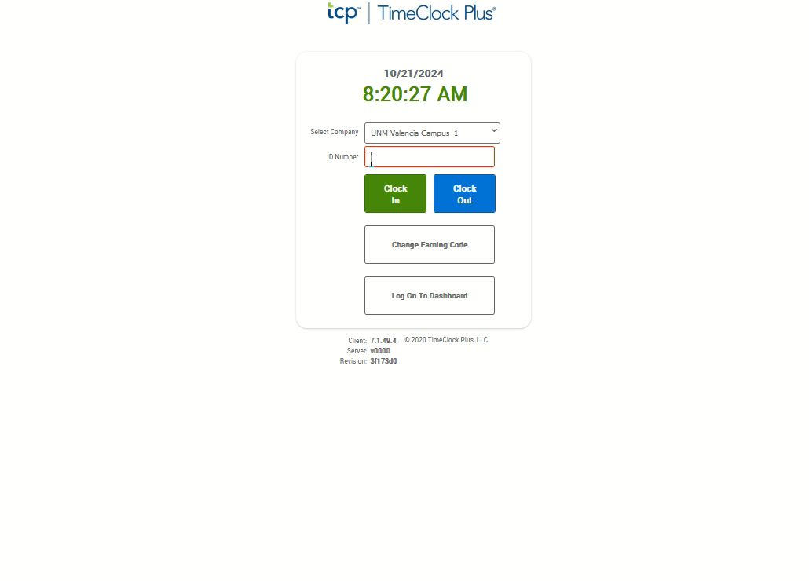
Clocking In
If not auto started, Click the video to the right and push the play button located at the bottom to watch the demonstration.
From the TCP Page, enter your nine-digit Banner ID in the ID Number Box.
Click the green “Clock In” button.
Enter your four-digit PIN.
Click “Log on.”
From the Clock-In Confirmation Screen, click the “Continue” button.
From the Select Earning Code Screen, click the “Continue” button. The earning code should remain selected as “Bi-weekly Regular.”
You should receive a “Clock In Successful” notification. Be sure to click the “OK” button to complete the clock in.

