Slide 1
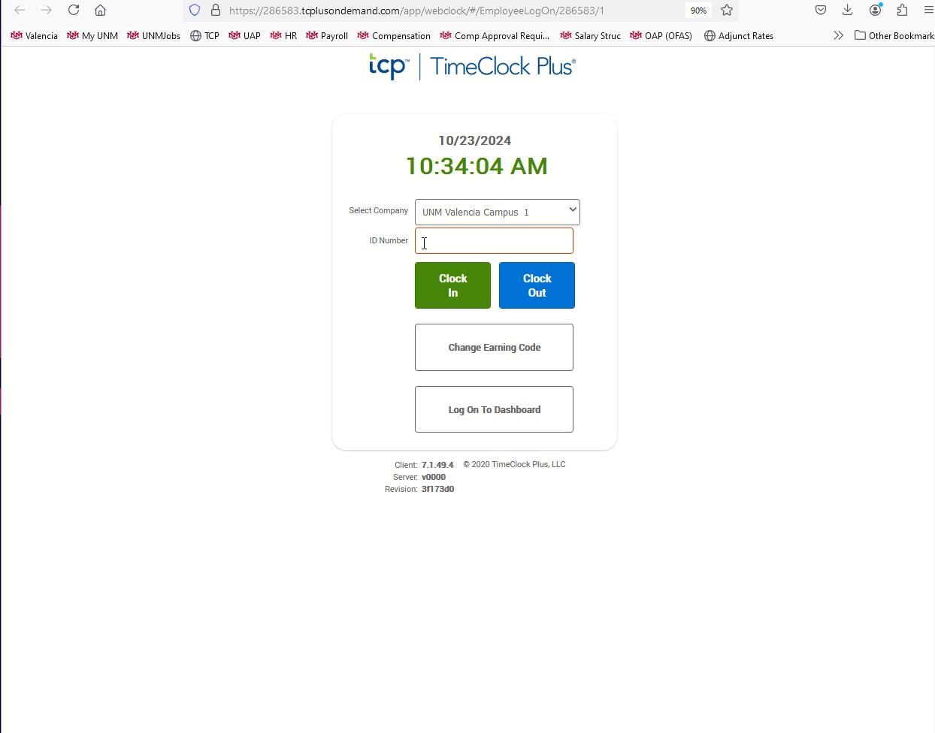
Changing your PIN
If not auto started, Click the video to the right and push the play button located at the bottom to watch the demonstration.
From the TCP home screen, enter your nine-digit Banner ID number in the ID Number Box.
Click the “Log On To Dashboard” button.
Enter your four-digit PIN in the PIN box and then click the “Log On” button.
In the top right-hand corner, select the “My Options” button. If the button is not visible, click the stacked three dots, then click the “My Options” button.
Enter your current four-digit PIN in the Current PIN box.
Enter your new four-digit PIN in the New PIN box.
Re-enter your new four-digit PIN in the Re-enter PIN box.
Click the “Update” button.

