Slide 1
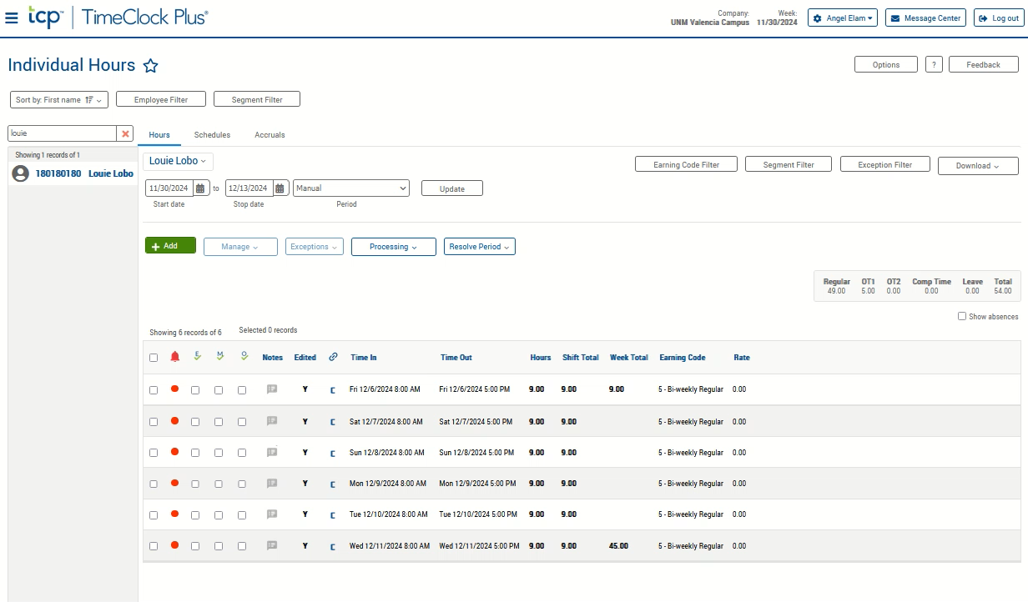
Supervisor Approval
If not auto started, click the video to the right and push the play button located at the bottom to watch the demonstration. This video starts with step three.
Click the 3-line “hamburger” menu icon to access the toolbar.
Select Hours, Individual Hours.
Select the Employee from your list on the left.
Ensure your time-period start and stop dates are correct. Change if needed.
Verify the time and clear any special notifications.
  Ensure the total hours worked are accurate in the Week Total Column for each week.
  Ensure all hours meet the rounding requirements in the Hours column. The Hundredths column should always be zero.
    If changes are needed, please reach out to timekeeping.
  Clear any notification flags such as Missed In/Out, Short Break, etc., using the Resolve Period drop-down button.
    Click on Resolve Period drop down, choose “approve” for the necessary areas.
    Click apply.
  Repeat step three for comp or overtime.
    All comp and overtime should be preapproved in writing.
    No Leave and OT in same week.
  Approve/Sign by checking each of the check boxes under the M✓ column, or by hovering over and clicking the M✓ header.

