Slide 1
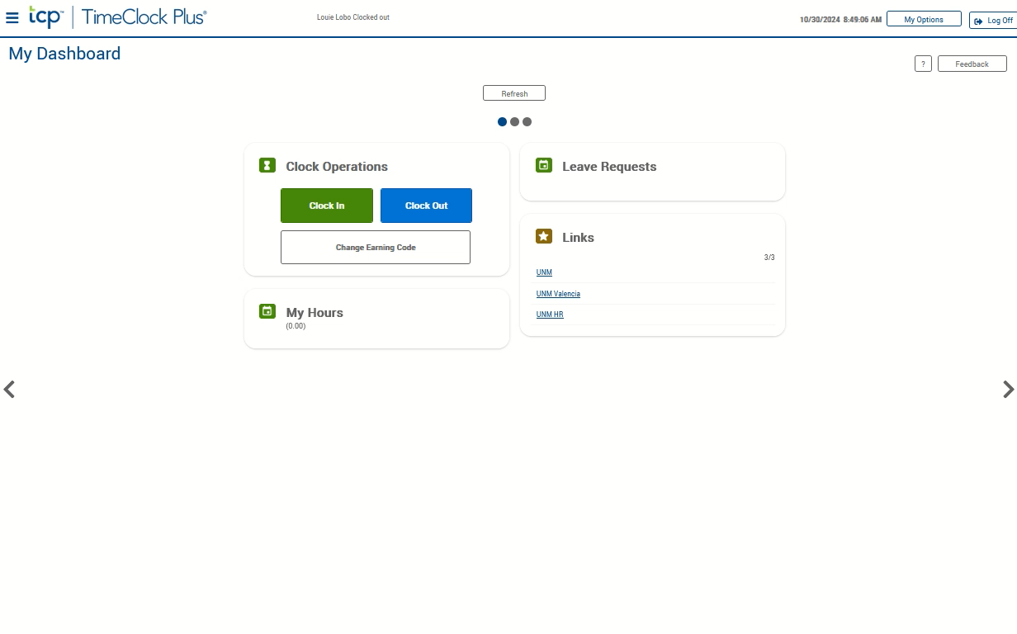
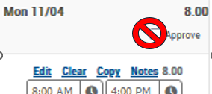
Projecting Time
The hours for Wednesday – Friday of the second week of the pay period are projected, as time is due before the week is over. We project time using the Manage Timesheet function in TCP. Projected time can also be used when working off campus.
If not auto started, click the video to the right and push the play button located at the bottom to watch the demonstration.
Click the 3-line “hamburger” menu icon to access the toolbar.
Click Manage Timesheet.
Click the “add” button on the date you are adding projected time.
Adjust the times on the segment.
To add additional time segments to the same date, repeat steps three and four.
If you are working the same time frames on other dates, you can copy the time segments already entered by clicking the copy button above the time segment. When the calendar dialog box appears, click the date the time segment will apply to. Click the paste button. If you are working different times, use steps three and four on each date.
Be sure to click the “Accept” button located at the top left hand corner of the page to save the time. Do not manually check the approve button above each date.

