Slide 1
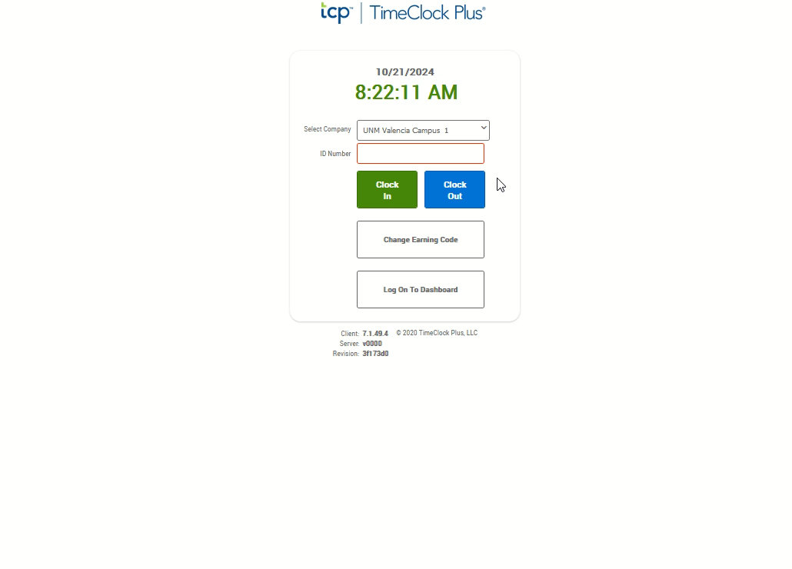
Missed Clock In
If not auto started, click the video to the right and push the play button located at the bottom to watch the demonstration.
From the TCP Page, enter your nine-digit Banner ID in the ID Number Box.
Click the blue “Clock Out” button.
Enter your four-digit PIN.
Click “Log on.”
The system will recognize that you are trying to clock out, but are missing a clock in. From the “Missed Clock In” confirmation screen click the “Continue“ button.
The next screen will confirm your last clock out time and ask if you need to manually enter a missed clock in. Click the “Continue” button.
On the Time Entry Missed Clock In screen, enter the date and the time of the missing clock in. This is a manual entry, so be sure to use the rounding/cross-walk to enter the rounded time.
Enter a note in the note field.
Click the “Continue” button.
From the Select Earning Code Missed Clock In screen, click the “Continue” button. The earning code will remain at bi-weekly regular.
From the Summary Missed Clock In screen, confirm your entry is accurate for the missing clock in. If needed, click the “Back” button to correct. When accurate, click the “Continue” button.
From the Clock Out Operation Successful dialog box, click “OK”. Both your missed clock in and your current clock out time are now recorded.

