Slide 1
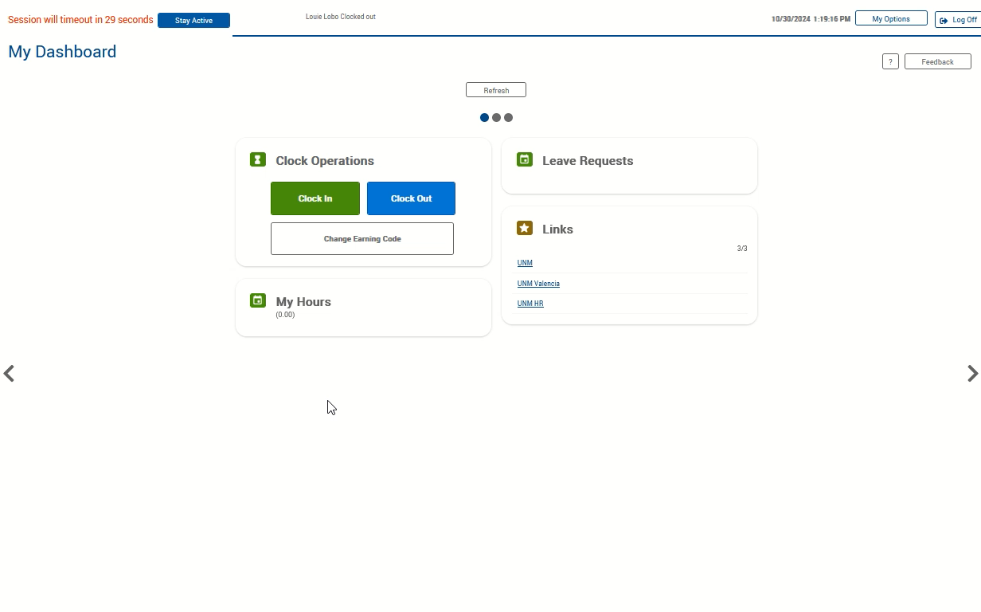
Approving Time
If not auto started, click the video to the right and push the play button located at the bottom to watch the demonstration.
Click the 3-line “hamburger” menu icon to access the toolbar.
Select View, then Hours.
Use the navigation arrows (Prev and Next) to move to the first week of the pay period.
Hover over the E/Check Mark header and click it to select the boxes for all the time segments.
When the dialog box populates, and you agree that the time you are certifying is accurate, click the Yes button.
Use the navigation arrows to move to the second week of the pay period.
Hover over the E/✓ header and click it to select the boxes for al the time segments. Note, checking the boxes is equivalent to your signature verifying the time submitted is accurate. Make sure all the boxes now have a blue check mark. If yes, your time is now approved/submitted.

