Slide 1
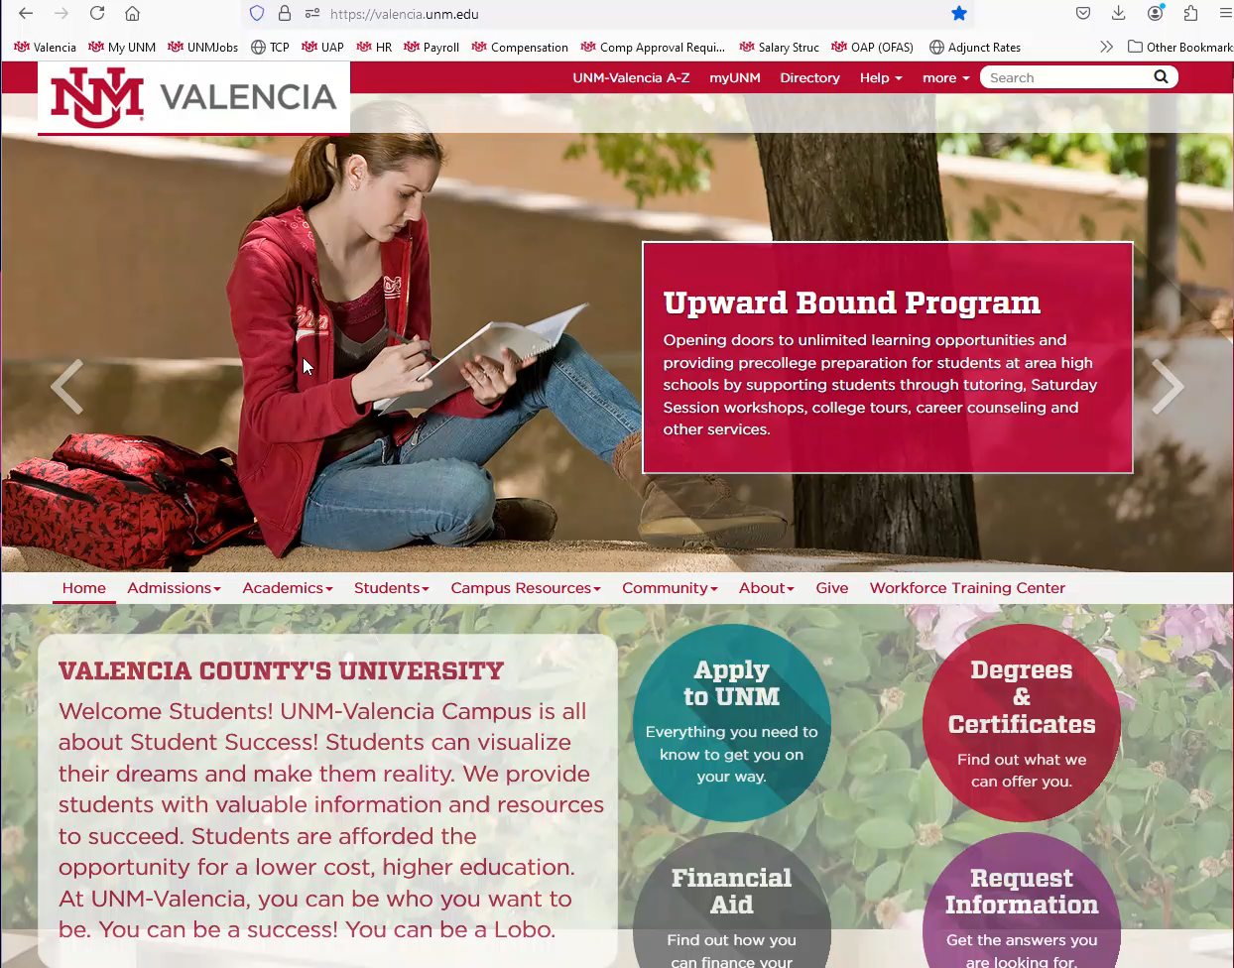
Accessing the TimeClock Plus® (TCP) Site
If not auto started, Click the video to the right and push the play button located at the bottom to watch the demonstration.
Navigate to the UNM-Valencia website at Valencia.unm.edu.
From the tool bar located under the picture, select Campus Resources, Business Services, then Timekeeping.
Scroll to the bottom of the screen and under the Log In Links title, select “Employee.”
  If you need your PIN reset, please contact Valencia HR.

