Slide 1
Meet the UNM Online Student Success Team
UNM-Valencia OTEx Conference 2023

Slide 2
What is UNM Online?
UNM Online is an administrative support unit that works with faculty, staff, and students to build quality online programs and make them accessible to non-traditional students, working adults and geographically dispersed learners.
THE UNIVERSITY OF NEW MEXICO

Slide 3
What does UNM Online do?
Marketing, Recruitment, Outreach, and Student Success
Curriculum Development, Course Scheduling, and Compliance
Data Analytics and Management
Notes:
Tina

Slide 4
Meet the UNM Online Student Success Team
online.unm.edu/readiness/aboutus
Tina Zuniga, MA, ABD
Program Planning Officer
Rick Robb, MFA
Sr. Student Success Specialist
Olivia Torres Jojola, BA Student Success Specialist
UNM Online’s student success specialists are experts in “wayfinding.” They have insight into the academic and support services successful students rely on.
Email Campaigns: Welcome, midcourse, and graduation
Advisement Hours
Notes:
Olivia – integrated advisement, not academic advisement – don’t lift holds, support – Grew up close to Valencia

Slide 5
UNM-Main’s Online Student Population
Fall 2022 AOP Student Profile
Average Age: 33
60% Female, 40% Male
51% Graduate, 49% Undergraduate
82% are NM Residents
42 students from Valencia County
Most Popular Majors by Student Headcount
Business Administration
Project Management
Cybersecurity & Business Analytics
Psychology
Notes:
TIna

Slide 6
30+ degree and certificate programs plus minors offered fully online and administered by UNM Academic Units.
What Do We Offer?

Slide 7
Students Have Options!
14 Undergraduate Degrees
19 Graduate Degrees
2 Certificate Programs
22 of these are Accelerated Online Programs (AOP)
9 Accelerated Online Program minors
Online programs can be offered in 8-week or 16-week format or synchronous or asynchronous format, depending on the program
Same straight-forward admissions process as other degrees at UNM
Specialized student support offered by UNM Online
Notes:
Olivia

Slide 8
Accelerated Online Programs
online.unm.edu/online-degrees/accelerated-online-programs
Accelerated Online Programs are designed for online delivery.
AOP courses are:
Created and taught by the same faculty who teach these and other courses at the University.
Available for development support by professional instructional designers
Follow recommended best practices for teaching
Quality reviewed
AOPs feature:
Courses offered in an 8-week format
Affordable, flat per-credit-hour tuition rates regardless of residency
Access to specific course sections only for AOP students
Five entry points throughout the year (First-Half Term, Second-Half Term, Summer)
Notes:
Olivia

Slide 9
AOPs Are
“Degree completion” programs
Asynchronous format – no required meeting times
Perfect for students who work during the day, take care of family members, or live too far to commute to Main campus.
AA/AS or equivalent credit hours make students ideally positioned for these programs.
Completion depends on the amount of time students can dedicate to their coursework.
You can complete your degree in about two years.
With Accelerated Online Programs, you can cut the time in half.
Notes:
Olivia

Slide 10
Undergraduate Degrees
online.unm.edu/online-degrees
Business Administration (BBA)
Chicana & Chicano Studies (BA)
Community Health Education (BS)
Economics (BA)
Instructional Technology & Training (BS)
Intercultural Communications (BA)
Interpersonal Communications (BA)
Liberal Arts (BALA)
Native American Studies (BA)
Psychology (BA)
Strategic Communication (BA)
= Accelerated Online Program
Notes:
Olivia
• BBA and Psych have been among our most popular undergraduate programs.
• BA in LA offers you the chance to create your own degree plan.
• The ITT program through OILS is one that would go great with any career.

Slide 11
Undergraduate Degrees
online.unm.edu/online-degrees
Undergraduate programs in the health industry*:
Dental Hygiene Post-Licensure Program (RDH to BSDH) (AOP)
Nursing (RN-BSN)
Radiologic Science (BS)
* Note that admission to these three programs requires certification in the respective fields.
Notes:
Olivia – refer to HSC
Our other three Undergraduate degrees require licensure or certification in the specific field.

Slide 12
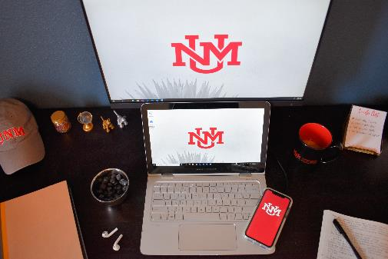
AOP Minors
online.unm.edu/online-degrees/accelerated-online-programs/minors
Chicana & Chicano Studies
Communication
Community Health Education
Economics
Human Services
Instructional Technology & Training
Journalism & Mass Communication
Native American Studies
Psychology
18-24 Credit Hours
Some program restrictions apply
Notes:
Olivia

Slide 13
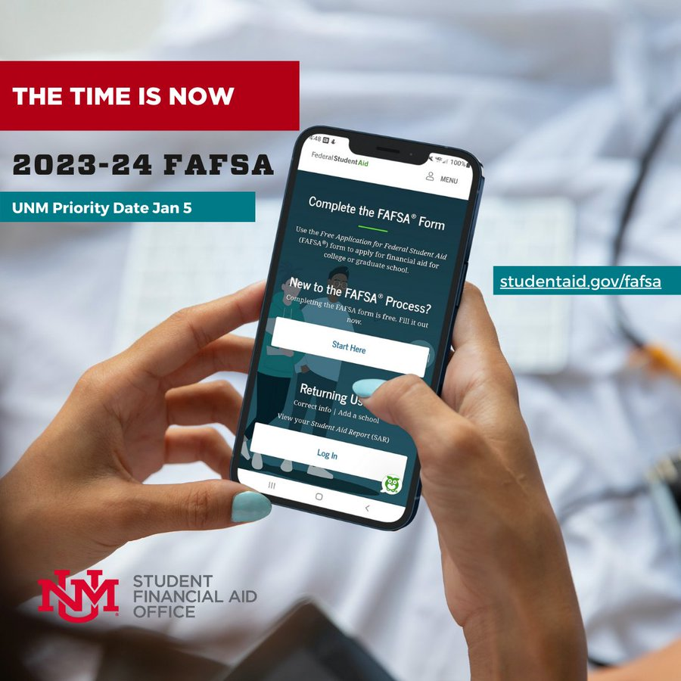
Tuition Rates & Financial Aid
AOP Tuition is Residency-Free (same rate for in-state and out-of-state students)
Spring 2023: $394.80 per credit hour
UNM Financial Aid and Scholarships still apply to AOP programs, including the Opportunity Scholarship
Notes:
Tina

Slide 14
UNM-Valencia Alumni in Online Programs
Elizabeth Ramsell
Bachelor of Business Administration, ‘23
Lorrey Romero
Master of Science in Cybersecurity & Business Analytics, ‘24
Notes:
Tina

Slide 15
Preparing Students for Transfer to Online
Identifying a transfer program early on (end of the second semester of the first year in college)
Complete as many Gen Ed requirements at the branch as possible
Staying mindful of attempted vs. completed hours for Financial Aid eligibility purposes
Connect with your transfer program Advisor
Notes:
Tina

Slide 16
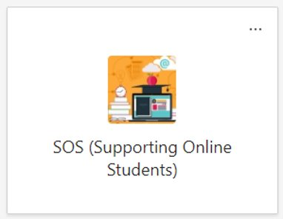
Stay in the Know
Supporting Online Students (SOS) Group
Academic Advisors from Main Campus and Branch Campuses
Meet monthly to discuss current issues, trends, and ways to improve online student success
Notes:
Olivia

Slide 17
Developing Partnerships with UNM Online
Student Referrals
Rick Robb or
Olivia Torres Jojola
(505) 277-9000
online@unm.edu
online.unm.edu
“Big Picture” Ideas or Initiatives
Tina Zuniga
zunigat@unm.edu
Message on Teams
Notes:
Olivia & Tina

Slide 18
Online Degree Programs Flexibility • Convenience • Choice
Rick Robb or Olivia Torres Jojola
(505) 277-9000
online@unm.edu
online.unm.edu
Facebook | Instagram | Twitter
@UNMOnline
Weekly Office Hours: Tuesdays & Thursdays
10 a.m.-12 p.m. Zoom Meeting ID: 967 7118 3893
THE UNIVERSITY OF NEW MEXICO
Notes:
Questions? Issues?

