Slide 2
Culturally Responsive Pedagogy in online classes
Justin Bendell
Assoc. Prof of English
UNM-Valencia

Slide 3
Goal
In this short session, I will non-exhaustively introduce the concept of Culturally Responsive Pedagogy and offer suggestions for how one might incorporate CRP practices into online classrooms.
*Stephanie Spong went into some detail on CRP in her keynote, so consider this a summary & reminder.
**inspired by the Grand Challenges initiative on Culturally Responsive literacy/pedagogy being led by branch campus faculty.

Slide 4
What is Culturally Responsive/ Relevant Pedagogy (CRP)
A “learning environment where every student’s cultures, languages, and life experiences are acknowledged, validated, and celebrated.” The term was introduced in 1995 by Gloria Ladson-Billings in “Toward a Theory of Culturally Relevant Pedagogy.”
Geneva Gay expanded on this work in 2000’s Culturally Responsive Teaching: Theory, Research, and Practice. Dr. Nicole West-Burns merged the two in 2008 and began to use the term Culturally Relevant Responsive Pedagogy (CRRP).

Slide 5
Characteristics of CRP
Active teaching methods
Communication of expectations
Cultural sensitivity
Classroom <- -> Community
Inclusion of students who are culturally and linguistically diverse
Small group instruction
Teacher as facilitator
Student-controlled discourse

Slide 6
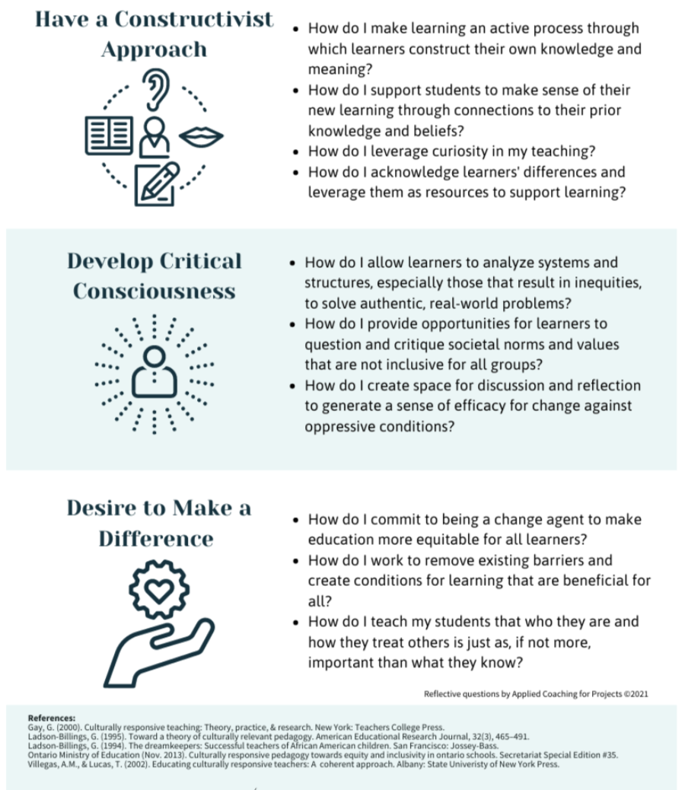
https://www.appliedcoaching.org/post/culturally-relevant-or-culturally-responsive-it-can-be-both

Slide 7
Culturally Responsive Teaching is Relational
Building trust-based relationships
Validating students
Supporting communal learners
Responsivity to student’s academic and social emotional needs
The classroom as not separate from community, but an extension of it.

Slide 8
How to make online classes culturally responsive
Building learning relationships online
“high-trust, low-stress environments can help marginalized students effectively process and retain learned information.”
Center students online
learner centered lessons, designed around student interests with student input
Support communal learners
incorporate collaborative work time, zoom breakouts, gamification & chats
Responsiveness
to students’ academic and social emotional needs; be flexible

Slide 9
Tips for CRP in online classrooms
Get to know your students on their terms
Introduce culturally meaningful aspects of yourself. Give space for your students to do the same. If you model openness, your students may respond in kind.
Engage students in critical self-reflection
Journaling, break out groups on Zoom, low-stakes freewriting
Create multimodal learning opportunities
A lesson on story plotting or the Krebs Cycle might include a reading, a video lecture, an educational game, an online museum visit, an online discussion, a freewrite, etc.
Use counter-stereotypic exemplars
Counter-stereotypic examples so students see themselves and others represented. Challenge the dominant cultural narratives of the moment. Open space.

Slide 10
In what ways have you consciously or unconsciously used CRP in your classes?
Add your ideas in the chat!
I’ll go first: labor-based grading

Slide 11
Faculty Responses 1
Share personal stories related to class content--I share and ask students to share.
NM has a lot of space/astronomy history (all the way back to Chaco Canyon!) so I include that every chance I get in my astronomy courses
Offering multiple way of showing how they are understanding the assignment.
End-of-Week Student Reflections: students dialogue w/ me one-on-one through these reflections about what they’re learning in class, other classes, and/or any struggles outside of school work.
Emphasizing New Mexico in U.S. history courses that are often very focused on the history of the eastern U.S.
breaking assignments into segments
Also good to point out that culturally responsive teaching means more accessible learning options for disabled students.

Slide 12
Faculty Responses 2
I support and encourage student choice in all assignments, and provide ideas they can choose from if they can’t or don’t want to think of something on their own.
Emphasize that each and every student has an important story to tell via art- whatever that means to them.
Be interdisciplinary.
multi-genres in an Intro Lit class, including narratives in comics and games chosen/presented by students
I ask students to pick their research topics for environmental issues in New Mexico for my first year biology. I use scaffolding in short assignments online. I’m trying it with my dual credit for the first time this year, I’m not sure to expect. But I’m excited to see.
Share that it took me a few times to get this right when I was in their position
I had an unsighted student in an online class. I assigned an online graphic short story that her screen reader couldn’t access. We Zoomed together and I read the story and described the pages. We then had a discussion. It was a good experience for her, and helpful for me to understand accessibility issues more deeply. In describing this student, I am using her terminology. (That’s another way to respond to CRP)
I'm working on a discussion "rubric" which suggests non-traditional ways to engage in discussion like creative responses or offering recommendations for further reading that de-centers the usual question-and-response discussion format
Sharing my own design mistakes so that students are comfortable making their own

Slide 13
Works Cited
Kristin Burnham, “5 Culturally Responsive Teaching Strategies,” 31 July 2020 https://www.northeastern.edu/graduate/blog/culturally-responsive-teaching-strategies/
Culturally Responsive Pedagogy Institute, Guttman Community College, CUNY, https://guttman.cuny.edu/faculty-staff/center-for-practice-technology-and-innovation-cpti/faculty-offerings/culturally-responsive-pedagogy-crp-institute/
Zaretta Hammond, ”Cultural Responsiveness Stars with Real Caring,” Learning for Justice, 8 February 2013 https://www.learningforjustice.org/magazine/cultural-responsiveness-starts-with-real-caring
Gloria Ladson-Billings, “Toward a Theory of Culturally Relevant Teaching,” American Education Research Journal, 32:3 (Autumn 1995)
Dr. Rachael Mahmood, “Online Teaching Can Be Culturally Responsive,” Learning for Justice, 31 March 2020 https://www.learningforjustice.org/magazine/online-teaching-can-be-culturally-responsive
Felicia Moore Mensah, “Culturally Relevant and Culturally Responsive: Two Theories of Practice for Science Teaching,” National Science Teaching Association, April 2022 https://www.nsta.org/science-and-children/science-and-children-marchapril-2021/culturally-relevant-and-culturally
Steven Mintz, “The Other CRT: Culturally Responsive Teaching,”Inside Higher Ed, 24 March 2022 https://www.insidehighered.com/blogs/higher-ed-gamma/other-crt-culturally-responsive-teaching
Christy M. Rhodes & Steven W. Schmidt, “Culturally Responsive Teaching in the Online Classroom, November 2018 https://elearnmag.acm.org/archive.cfm?aid=3274756

Slide 14
Questions?
If you would like the slides or works cited links, send me a note!
jbendell@unm.edu

