Slide 1

Q&A’s on Enrollment with the Chancellor
Notes:
NOTE:
To change the image on this slide, select the picture and delete it. Then click the Pictures icon in the placeholder to insert your own image.

Slide 2
Our Current State:

Slide 3
Enrollment Drops since 2015

Slide 4
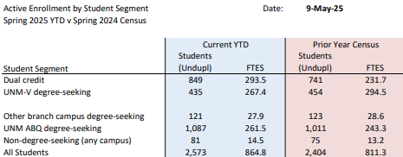
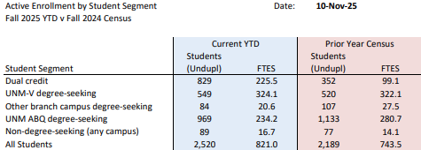
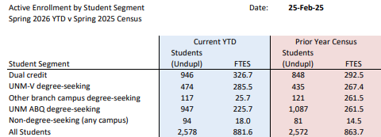
But how does that all break down?

Slide 5
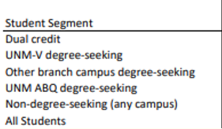
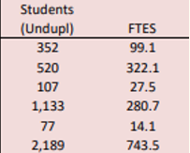
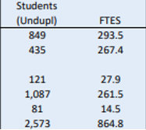
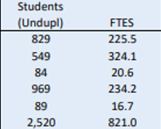
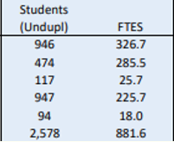
Looking at things annually
Fall
Spring
FY 2024 - 2025
Fall
Spring
FY 2025 - 2026

Slide 6
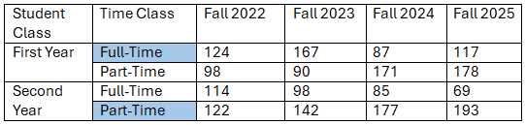
Full-time and Part-time Trends
First year is predominately full-time enrollment.
Second year is predominately part-time enrollment.

Slide 7
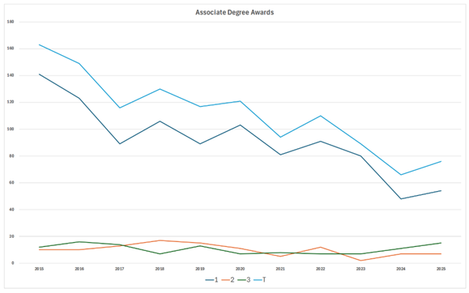
Award data on a graph:

Slide 8
Award Trends at UNM-Valencia
1
2
3
Total
2015 | 2016 | 2017 | 2018 | 2019 | 2020 | 2021 | 2022 | 2023 | 2024 | 2025
141 | 123 | 89 | 106 | 89 | 103 | 81 | 91 | 80 | 48 | 54
10 | 10 | 13 | 17 | 15 | 11 | 5 | 12 | 2 | 7 | 7
12 | 16 | 14 | 7 | 13 | 7 | 8 | 7 | 7 | 11 | 15
163 | 149 | 116 | 130 | 117 | 121 | 94 | 110 | 89 | 66 | 76
1 is the Humanities, Social Sciences, Business, and Liberal Arts.
2 is Math, Technical and General Sciences, and the Trades.
3 is Engineering and the Health Sciences.

Slide 9
Enrollment Increase Since COVID
Dual Credit Enrollment: DC Enrollment 2018-2024
Non-degree Enrollment: ND Enrollment 2018-2024
UNM ABQ Degree-seeking Enrollment: ABQ Enrollment 2018-2024
UNM Other Branch Degree-Seeking Enrollment: OB Enrollment 2018-2024
UNM-Valencia Degree-Seeking Enrollment: UNMV Enrollment 2018-2024
Total Enrollment: Total Enrollment 2018-2024

Slide 10
Enrollment Streams
Dual Credit
Spring of 2025: 33%
Fall of 2025: 32.9%
Spring of 2026: 36.7%
FTDS
Spring of 2025: 16.9%
Fall of 2025: 21.8%
Spring of 2026: 18.4%
ABQ
Spring of 2025: 42.2%
Fall of 2025: 38.5%
Other
Spring of 2025: 8.2%
Fall of 2025: 6.8%
Spring of 2026: 36.7%
Spring of 2026: 8.1%

Slide 11
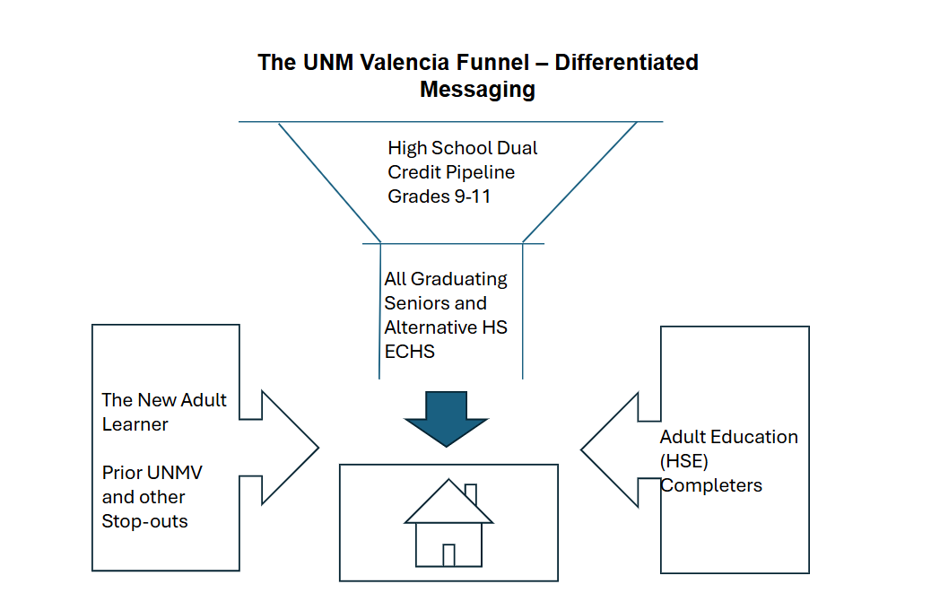
Student Funnel

Slide 12
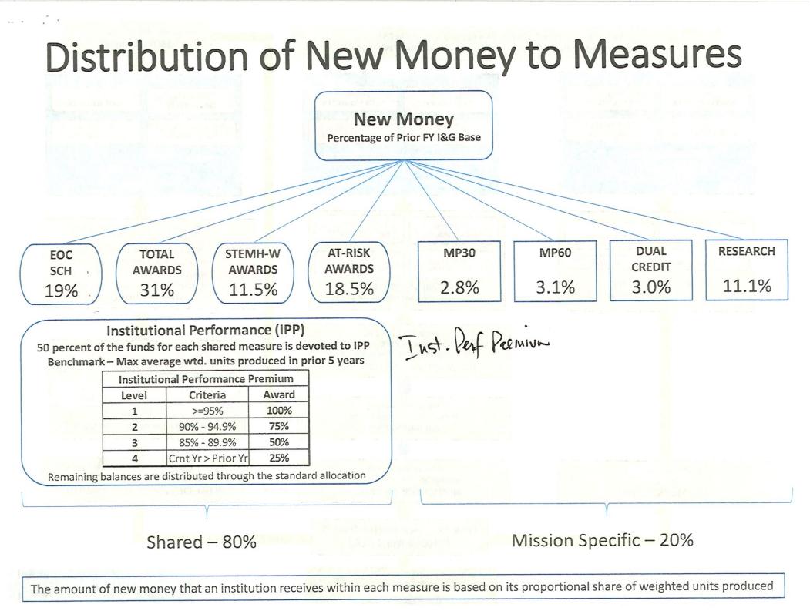
Where funding comes from

Slide 13
Enrollment is a hot topic. What does it mean for our budget?
Right now, enrollment growth and revenue from the funding formula have not kept pace with “must-fund” compensation, CBA, and insurance costs.
There is a 20.1% health insurance cost increase for FY 2027 – those costs are funded by the institution at a rate of:
80% if you are below $54,999
70% if you are between $55,000 and $69,999
60% if you are above $70,000
This means our budget for FY2027 is underwater $588,333.02.
Vacant positions are being evaluated right now, not eliminated, because we want to see what the budget firms up to be.
We do anticipate waiting to fill some positions, to reduce the impact on the budget.

Slide 14
Context
UNM-Valencia started out as a pure transfer campus
We now need to pivot and move towards a comprehensive campus
Transfer and Career Tech Education offerings
In 2024, approximately 800 high school students graduated from our service area schools.
In 2025, 970 of them graduated.
“Enrollment in community colleges with a high CTE-program focus increased 16% from 2022 to 2023, as noted by the National Student Clearinghouse. In addition to this, 54% of Gen Z surveyed by New America have stated they believe a high school diploma is enough to secure a sustainable and lasting job upon completion.” – ACTE (2024)
67% of CNM students are destination-based: they are there for a program or certification.

Slide 15

What questions do you have?

Slide 16
Question the Chancellor has for you
What more can you do to fill your classes?

